Slide 1
BRAINSTORMING

Slide 2
Social Technology: through the years
Evolution
Improvement
Interaction
Depression
Suicides
Pros and cons
Bullying
Shopping
Groups
Anonymity
Insecurity
Mental Health
Attention
Environments
Architectures
Market
Data
Privacy

Slide 3
MAPPING

Slide 4
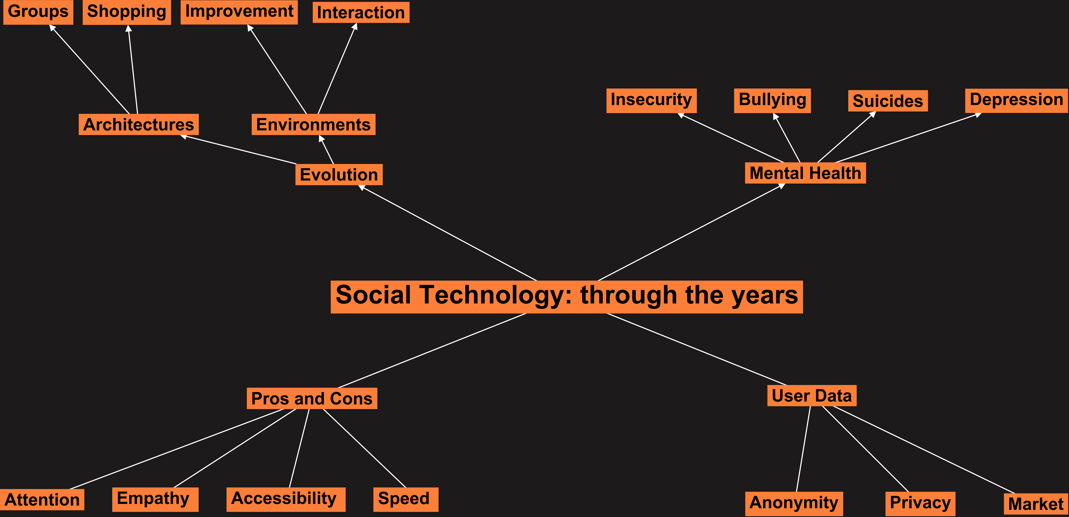

Slide 5
OUTLINE

Slide 6
Social Technology: through the years
Introduction
Beginning
Definition
First years
Evolution
Architectures
Way of living
Social Networks nowadays
Mental health
Privacy
In the future
Conclusion

